Slide 1
Modeling the effect of prior experience on noisy image classification in CNNs
By: Naresh, Shaoyun, Weishao, Boris, Yang, Jahan, Zahra
Group: Rendang | G1

Slide 2

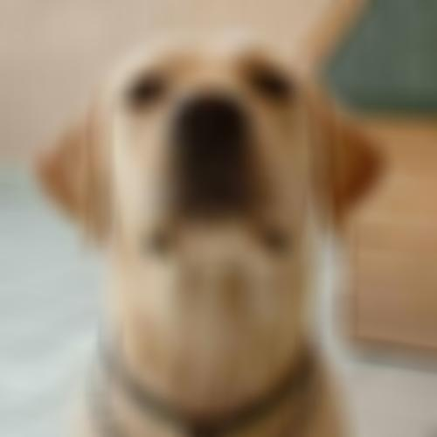
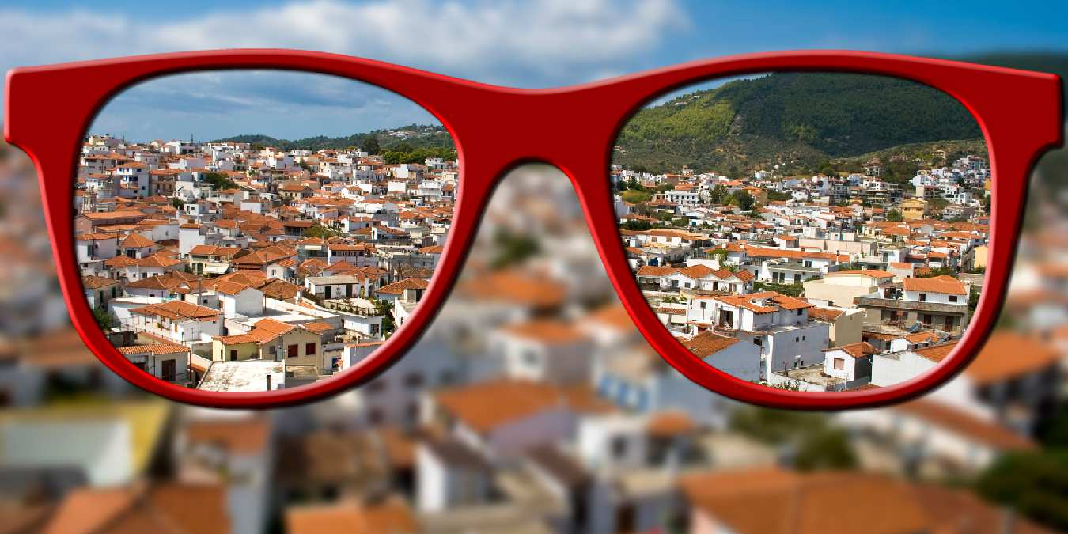
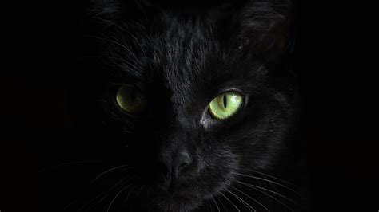
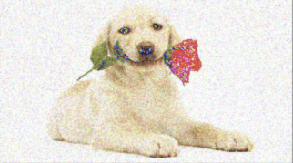
Introduction
Unlike the human visual system, image classifiers suffer from noisy conditions: Blurry, low-contrast, night-time or white noise.
How does the visual system in the brain solve noisy object classification?
Does prior experience with clean images help? To what extend?
Prior experience with clean images
?
Noisy classification accuracy

Slide 3
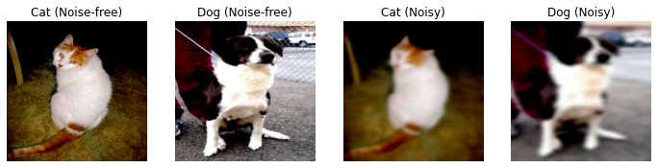


Models and Hypotheses
Two AlexNets, trained on the Asirra dataset (clean and blurry, cats and dogs images).
VS
Training
The naive learner
The expert learner
Training
Pre-training
Hyperparameter tuning: The tuned expert learner outperforms the naive learner.
Different sources of noise with different complexities: Expert learner outperforms naive learner in other noisy scenarios. In addition, how does image pixel variability relate to model performance.
Model’s representations vs brain imaging data: The internal representations of the expert model better aligns with fMRI data we get from Abdelhack’s lab [Abdelhack, M., & Kamitani, Y., Sharpening of Hierarchical Visual Feature Representations of Blurred Images (2018)].

Slide 4
Result 1, Hyperparameter tuning.
The tuned expert learner in most cases outperforms the naive learner.
Expert learner shows a more consistent performance across different ranges of hyperparameters.
Learning rates | 5e-3 | 1e-3 | 3e-4 (default) | 1e-4 | 1e-5
Naive learner | 69.65 | 85.04 | 86.93 | 84.88 | 80.03
Expert learner | 81.80 | 88.09 | 89.25 | 88.29 | 81.72
Optimizers | Adam (default) | AdamW | RMSprop | SGD
Naive learner: | 87.17 | 85.85 | 78.39 | 82.17
Expert learner: | 88.65 | 88.05 | 88.05 | 85.70
Batch sizes | 64 | 128 (default) | 256
Naive learner: | 87.85 | 85.45 | 85.08
Expert learner: | 87.81 | 89.17 | 88.89
Loss functions | Cross-entropy (default) | MSE | BCE | BCE With Logits
Naive learner: | 85.45 | 84.48 | 86.05 | 86.41
Expert learner: | 89.17 | 88.33 | 88.13 | 89.94
Alexnet architectures | 1 less FC layer | Default | 1 more FC layer
Naive learner | 86.13 | 87.37 | 85.97
Expert learner | 88.93 | 90.42 | 88.93
Notes:
Yang: In our first hypothesis, we want to know what’s the impact of hyperparameters on the model’s performance. We compared the performance of both models using different learning rates, batch sizes, optimizers, loss functions and Alexnet architectures. Our results show that, the tuned expert learner in most cases outperforms the naive learner. In addition, expert learner shows a more consistent accuracy across different ranges of hyperparameters.

Slide 5
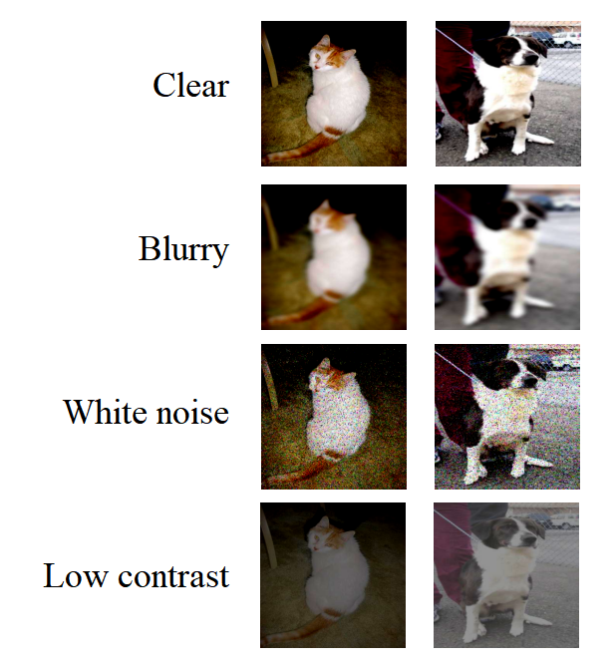
Result 2.1, Other sources of noise.
The expert learner outperforms naive learner in all noisy scenarios.
Expert learner performs better on noisy images than clear images!
Training on noisy images improves the performance, but at the cost of performance on clean images. This seems like a phenomena unlike human vision, since we don’t lose our capacity to identify clean images after seeing many noisy images.
Blurry | Clear | Noisy
Naive learner: | 88.53 | 87.37
Expert learner | 86.21 | 90.42
(std=5)
White noise | Clear | Noisy
Naive learner | 87.97 | 89.98
Expert learner | 87.41 | 90.90
(std=0.2)
Low contrast | Clear | Noisy
Naive learner: | 87.05 | 90.30
Expert learner | 88.21 | 92.58
(factor=0.3)
Notes:
Naresh: For our 2nd hypothesis we tested the naive and expert learner on different sources of noise. The default noise tested was blurry images using Gaussian smoothing. We additionally used white noise and low contrast to simulate night time vision. We observed that the expert learn outperforms the naive learner in all the noisy scenarios. Additionally, we observed that the expert learner is performing better in noisy cases compared to clear images.

Slide 6
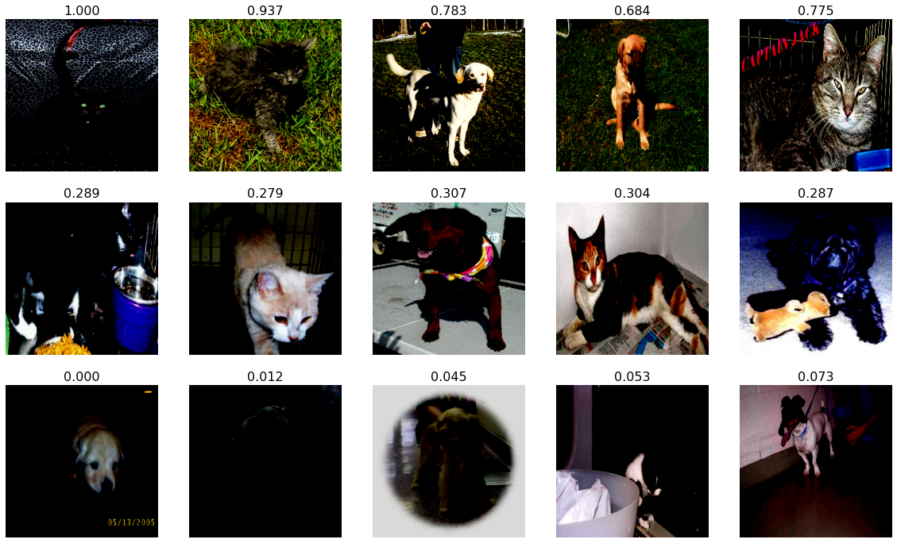
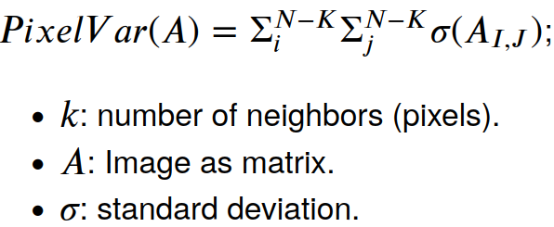
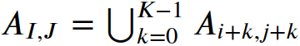
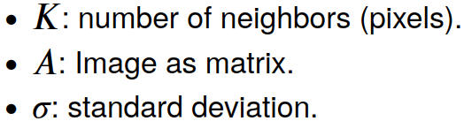
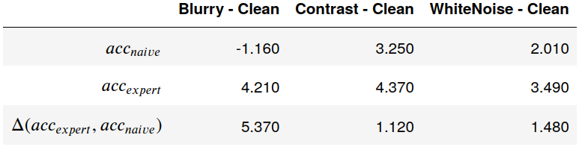
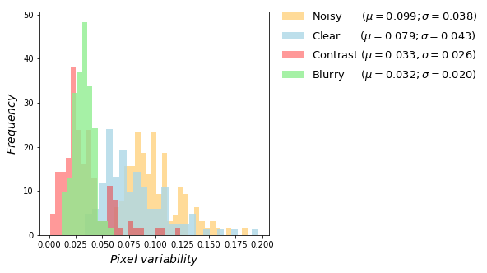
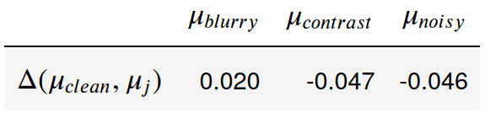
Result 2.2, Pixel variability and model performance.
Pixel variability index:
Increasing pixel variability (scaled)
(1)
(2)
(3)
Difference of accuracies may be explained from the complexity of images (i.e., variability between nearby pixels).
Notes:
+ Naresh presented the accuracy of models for clean and distorted images.
+ Here we wonder if the variability of pixels in an image affects the performance of models.
+ We measure the variability of pixels to each image and filter (noise, blur, contrast). Plot shows distribution for each filter.
+ (1) Comparison of accuracies: if we use the accuracies for Clean images as baseline, we computed the differences between accuracies between filters vs clean images.
+ (2) Comparison of means: we compared the distances between the mean (center) of each distribution vs the distribution for clear images.
+ (from (1) and (2)): these values show a high correlation. This may indicate that the difference between naive and expert accuracies may be explained from the pixel variability of images.

Slide 7
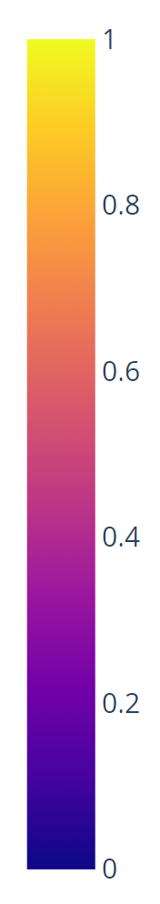
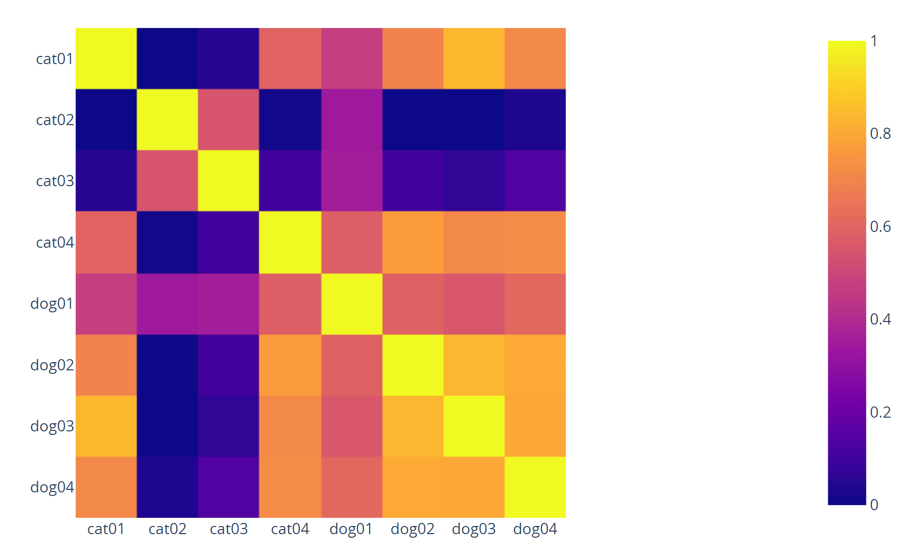
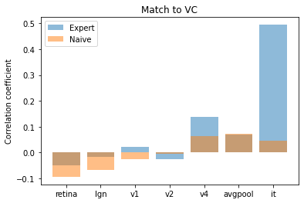
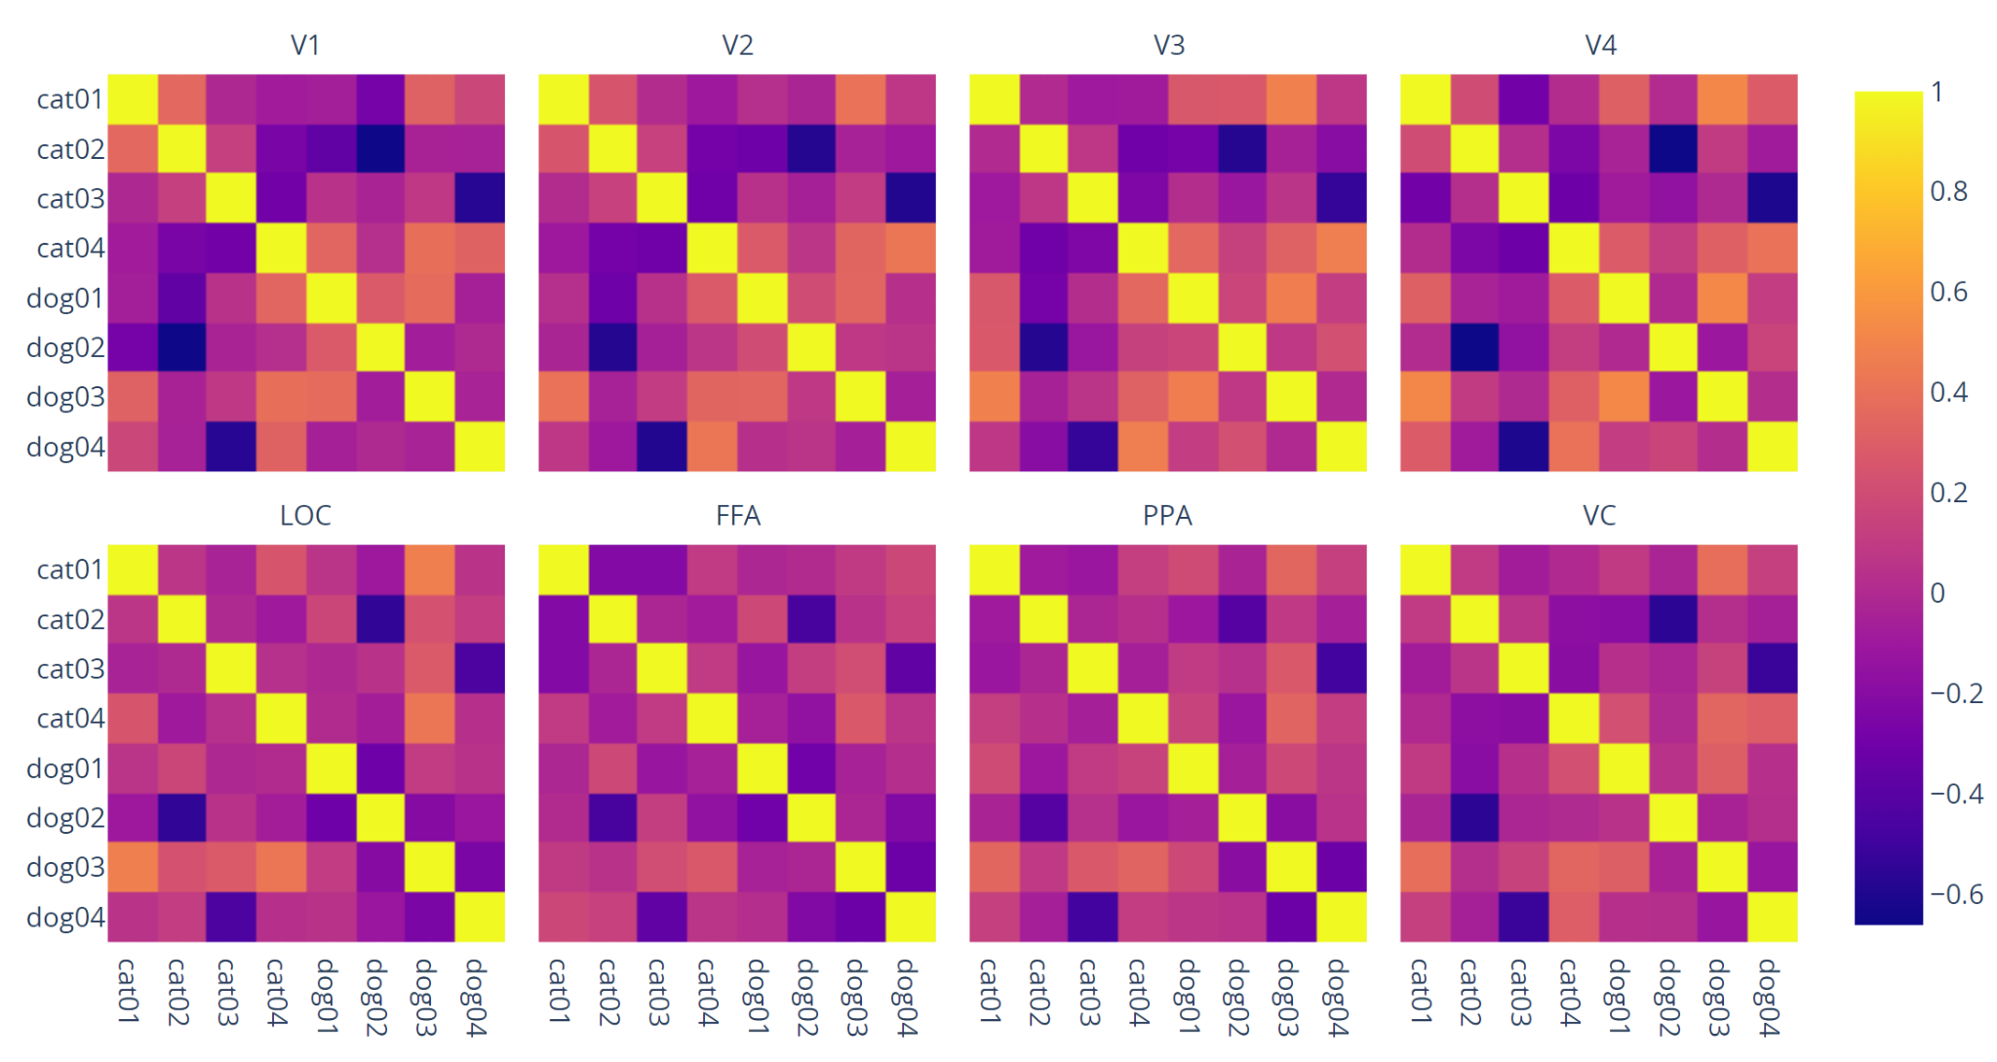
Result 3, Model’s representations vs fMRI data.
Images: Abdelhack & Kamitani (2018) *Only upper halves are displayed for copyright protection
Model’s internal representation correlates with classification predictions
[1, 0, 0, 1, 1, 1, 1, 1]
0: cat
1: dog
Correlation Model- & fMRI-based RSMs
Expert Model’s RSMs (Example: Final Hidden Layer)
fMRI:A & K (2018) Subject 1
Expert’s last layer it had better correlation with the Visual Cortex (VC) ROI (among others)
Model layers
&
Visual cortex
Correlation
~
RSMs from visual cortex
Mistake
Mistake
BOLD responses to the blurred cat & dog images
we fed to the models
Model layers
Notes:
RSM
@shaoyun: I censored part of the A & K (2018) images because redistribution is NOT allowed without their permission.

Slide 8


Conclusion and future work
Prior experience helps the learner, since:
The expert learner is performing better and more consistently across:
Different ranges of hyperparameters (1st hypothesis).
Different sources of noise (2nd hypothesis).
Difference in models accuracies may be affected by the variability of nearby pixels of images. However, the expert model has a better performance.
The internal representation from hidden layers(AlexNet) of expert learner has a higher correlation with fMRI BOLD signals (3rd hypothesis).
Future work:
Weights from pretrained network vs trained network might have different RSM results.
Test the model on fMRI data of other subjects.
We can use the fMRI BOLD signals to finetune the expert learner to predict the noisy images better.
How the complexity of different levels of the image affect the model performance differently? (expert vs naive learner).

Slide 9
Thank you so much for your attention! :)

